Slide 1
Nike
Sports Apparel Analytics
Sam Ferrara, Renu Deepya Iska, Vishnu Joshi, Shivani Patel, Asritha Yerranarasannagari

Slide 2
Table of Contents
Background
Company Profile
Sample Products
Existing Systems
Business Life Cycle Approach
High-Level BUS Architecture Matrix
Opportunity Matrix
Prioritization Grid
SWOT Analysis
Detailed Level BUS Matrix
Star Schema - Sales
Logical Fact Table
Dimension Detailed Description Table
Detailed Fact Tables
Conformed Dimensions
Two-Way Aggregate Table
OLAP Cube
Dashboards
Conclusion

Slide 3
Background
Importance of Analysis: Understanding sales performance and customer behavior is crucial for Nike to optimize its marketing strategies and inventory management.
Objectives: Provide actionable insights to enhance Nike's competitiveness in the sports apparel market.
Sales Performance Analysis
Use dimensional modeling to identify patterns in Nike’s sport apparel sales
Inventory Optimization
Provide recommendations to optimize inventory levels and sales
Customer Analysis
Analyze Nike’s customer base to understand preferences

Slide 4
Company Profile
Nike Overview:
Founded in 1964 by Bill Bowerman and Phil Knight.
Mission: "To bring inspiration and innovation to every athlete* in the world."
Core Values: Innovation, Sustainability, Inclusivity.
Market Position: One of the world's leading sports apparel brands, with a strong presence in footwear, clothing, and accessories.
Target Audience: Athletes, fitness enthusiasts, and fashion-conscious consumers.

Slide 5
Sample Products
Nike's Sports Apparel Products:
Footwear: Air Jordan, Nike Air Max, Nike Free, etc.
Apparel: Nike Pro, Nike Dri-FIT, Nike Tech Fleece, etc.
Accessories: Nike Elite socks, headbands, bags, etc.
Features: Innovative designs, advanced performance technologies, and iconic branding.

Slide 6
Existing Systems
Internal Systems:
ERP System: Manages manufacturing, supply chain, and distribution processes.
CRM System: Stores customer information and interactions.
POS Systems: Capture sales transactions at retail stores and online channels.
External Data Sources:
Market Research Reports: Industry insights and trends.
Social Media Platforms: Customer sentiment and brand perception.

Slide 7
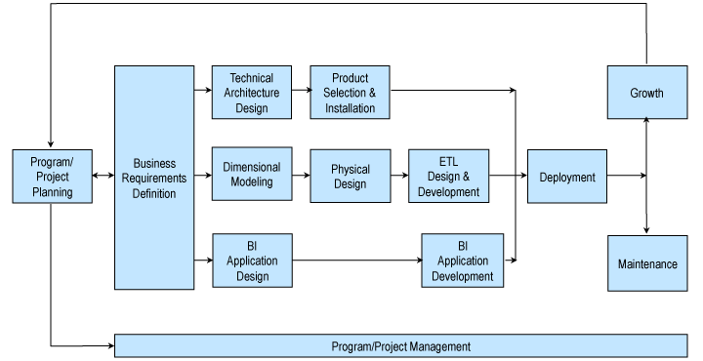
Business Life Cycle Approach

Slide 8
Business Life Cycle Approach
Analysis Approach:
Product Development: Identify market trends and consumer preferences to guide product innovation.
Marketing: Analyze the effectiveness of marketing campaigns and channels.
Sales: Monitor sales performance and optimize inventory levels.
Customer Retention: Understand customer behavior to enhance loyalty programs and personalized marketing efforts.

Slide 9
High-Level BUS Architecture Matrix
Processes
Product Design & Development
Manufacturing
Marketing & Branding
Product Sales
Distribution
Dimensions
Date
Customer
Apparel (Footwear, Accessories, Clothing, etc.)
Staff
Location (Region)
Warehouse
Shipping

Slide 10
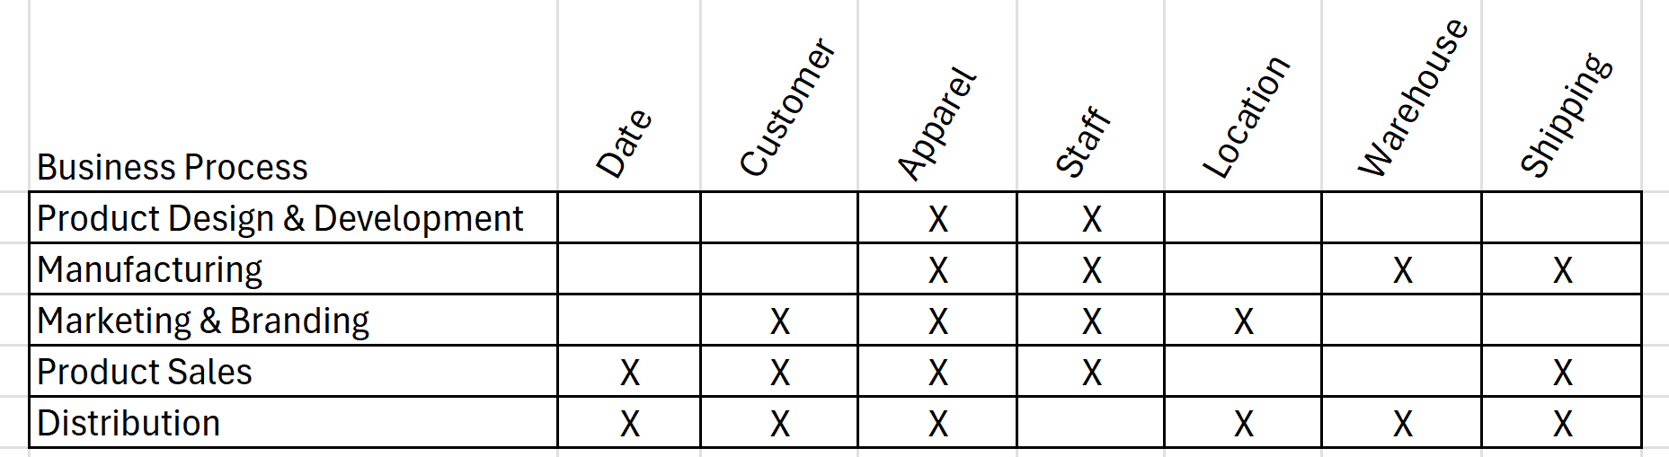
High-Level BUS Architecture Matrix

Slide 11
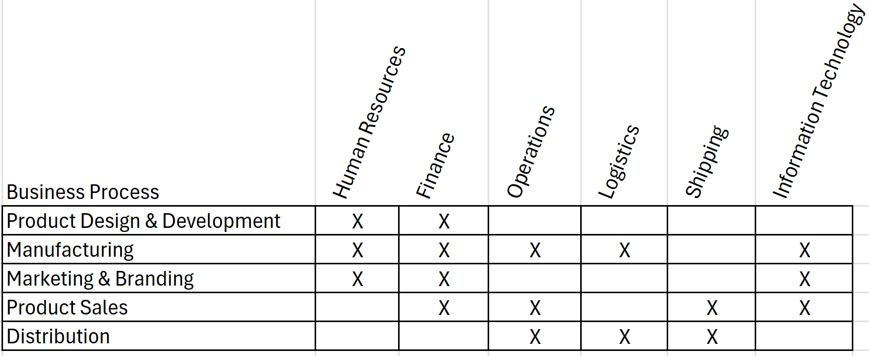
Opportunity Matrix

Slide 12
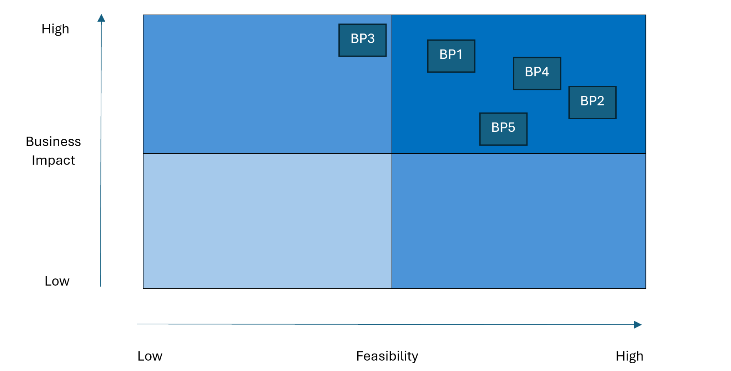
Prioritization Grid
BP1 - Product Design & Development
BP2 - Manufacturing
BP3 - Marketing & Branding
BP4 - Product Sales
BP5 -Distribution

Slide 13
SWOT Analysis
Strengths
Strong brand equity
Product diversification
Global presence
Weaknesses
Controversial labor practices
Environmental concerns
Counterfeit products
Opportunities
New and emerging markets
Customization of products
Sustainability
Threats
Growing competition
Shift in customer preferences

Slide 14
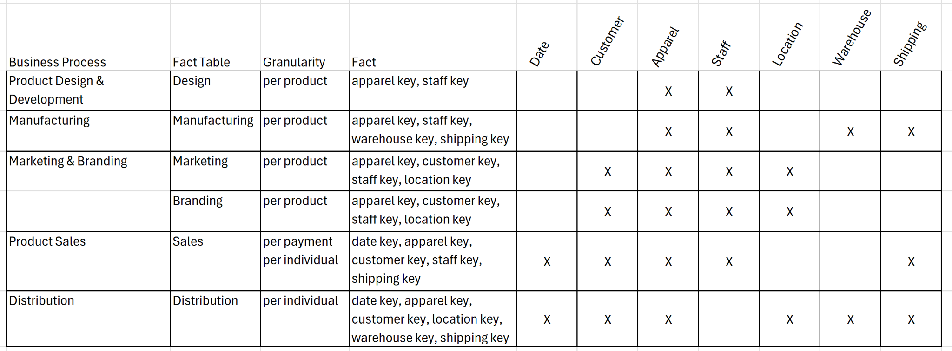
Detailed Level BUS Matrix

Slide 15
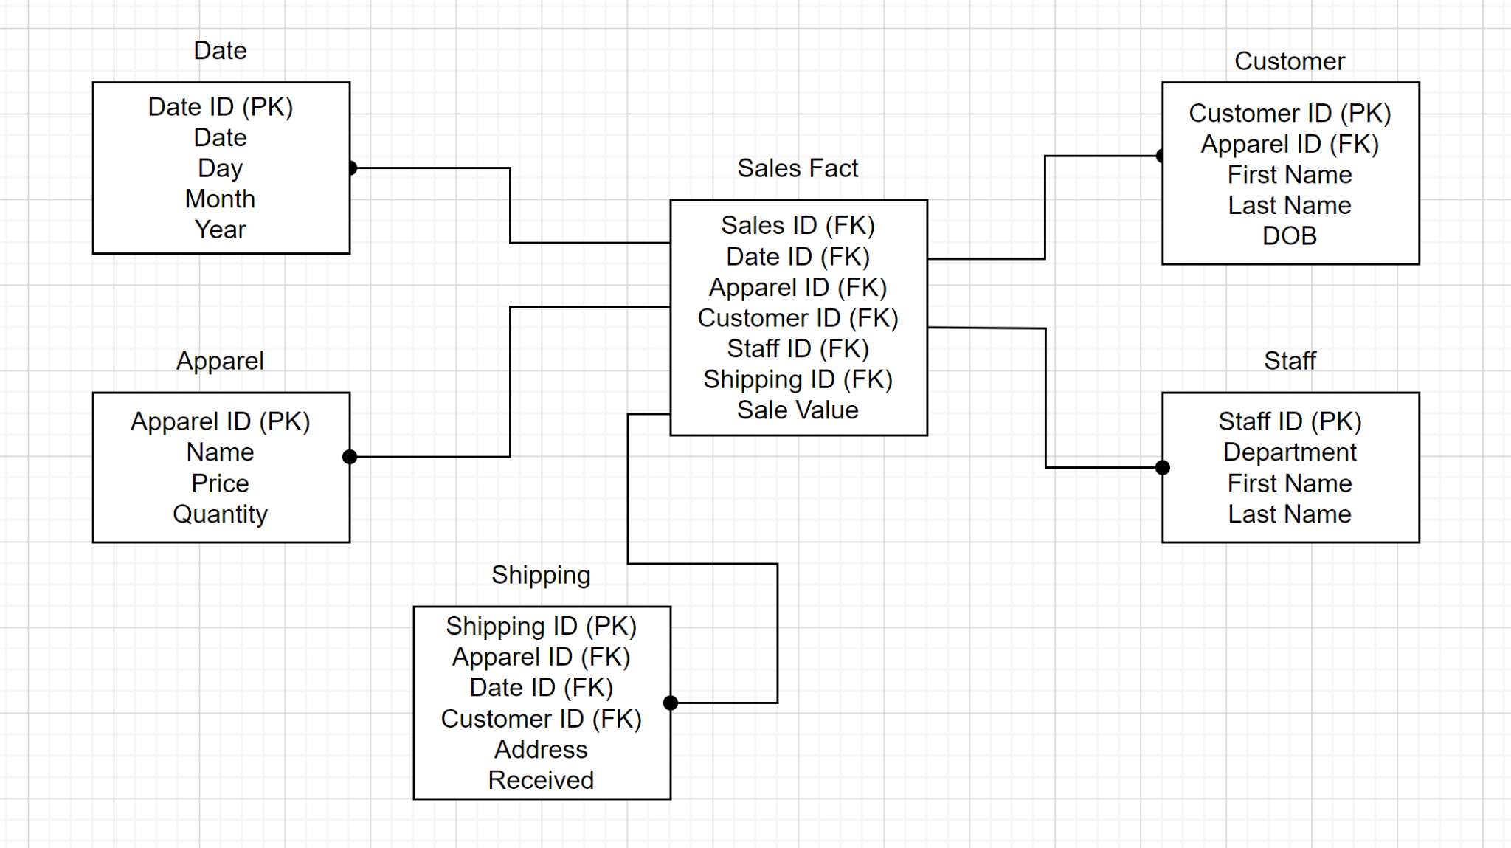
Star Schema - Sales Fact

Slide 16
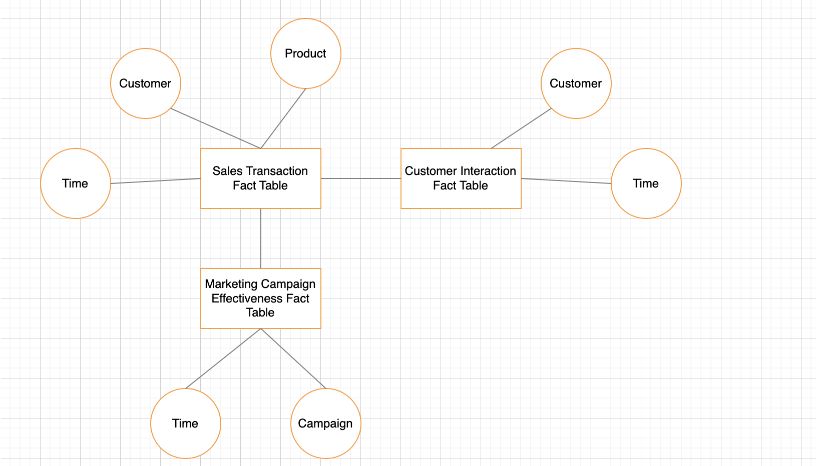
Logical Fact Table

Slide 17
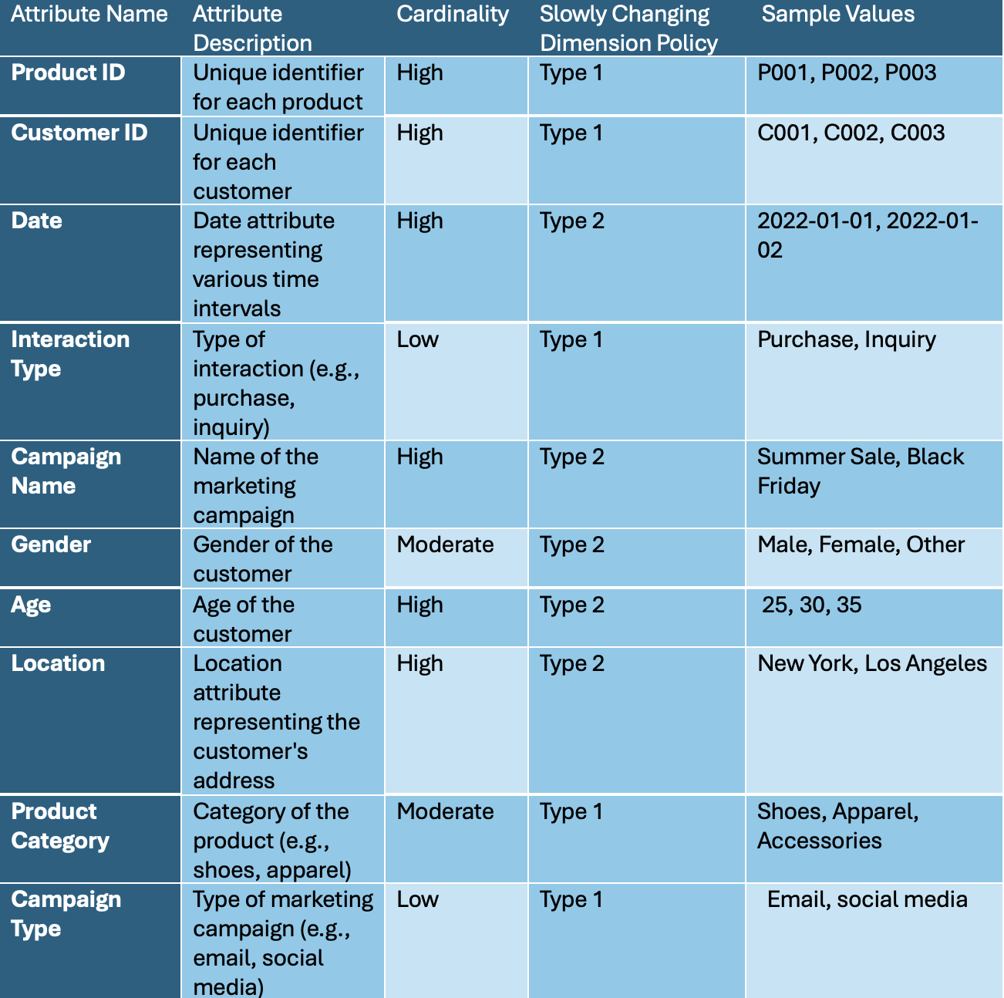
Dimension Detailed Description Table

Slide 18
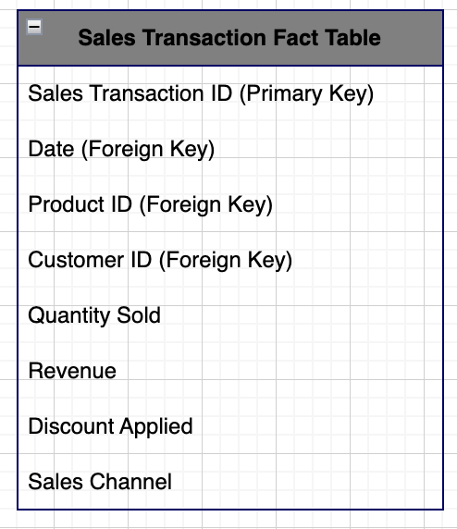
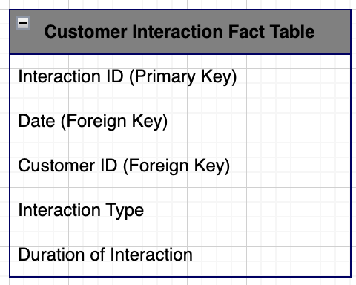
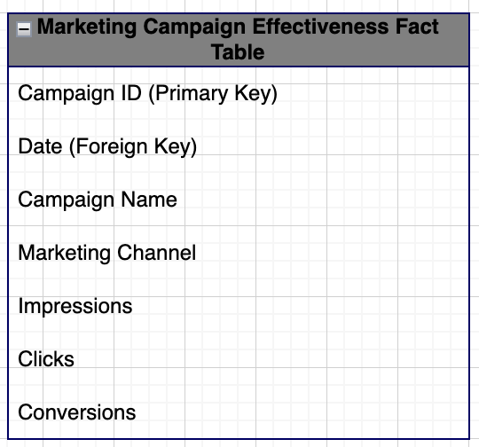
Detail Fact Tables

Slide 19
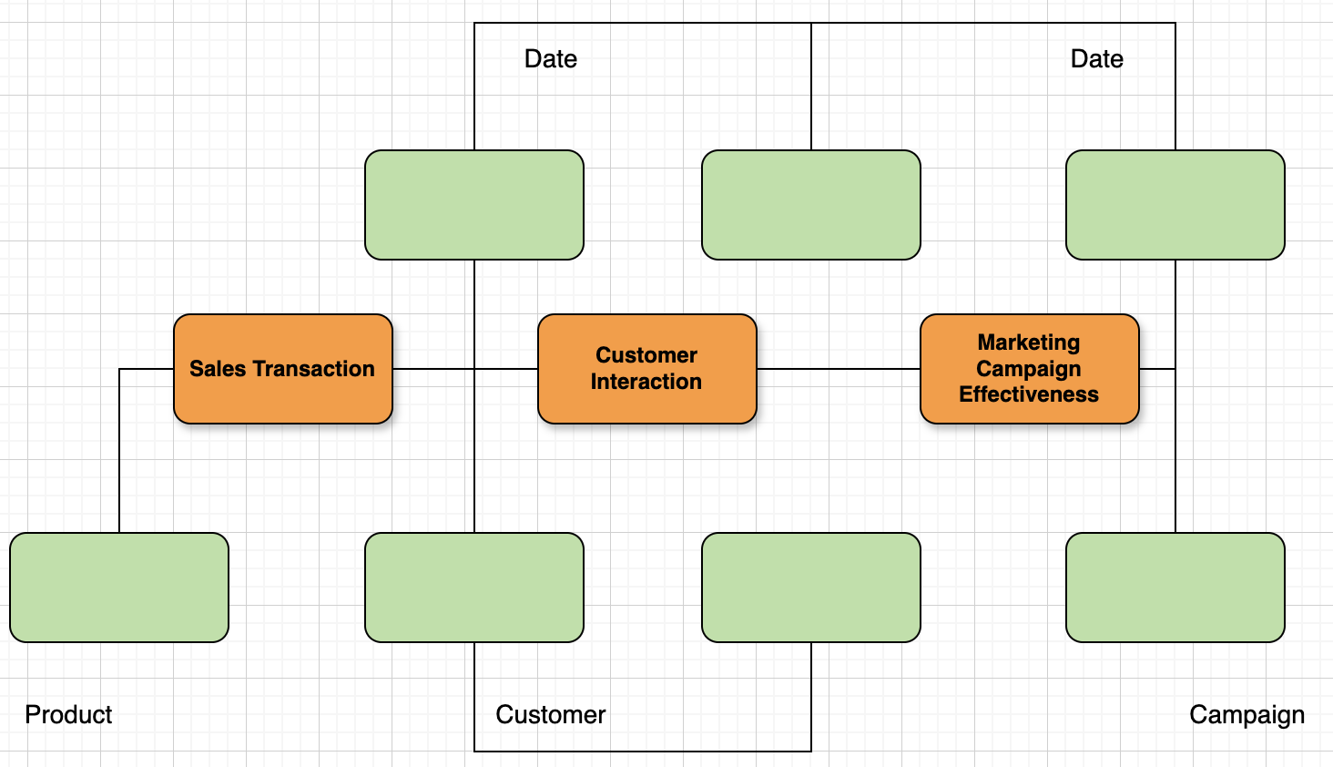
Conformed Dimensions

Slide 20
Two-Way Aggregate Table
Item Number | Item Type | Price | Availability | Shipping Date | Receiving Date
14226571 | Men’s Long Sleeve T-Shirt | 40 | In Stock | 09-Sep-22 | 16-Sep-22
13814665 | Women’s Soccer Jersey | 90 | In Stock | 13-Sep-22 | 18-Sep-22
13015648 | Men’s Overalls | 140 | Out Of Stock | 03-Sep-22 | 27-Sep-22
13809796 | Kids Tights | 22.97 | Out Of Stock | 02-Sep-22 | 21-Sep-22
13327415 | Kids Soccer Jacket | 70 | In Stock | 25-Sep-22 | 28-Sep-22

Slide 21

OLAP Cube
Date runs along the vertical axis, reflecting trends over time.
Customers (Customer ID, Address) form the horizontal axis, allowing us to segment and understand buying behavior.
Products (Apparel ID, Qty, Price) comprise the depth, providing insights into individual item performance.
Date
Customer
Product

Slide 22
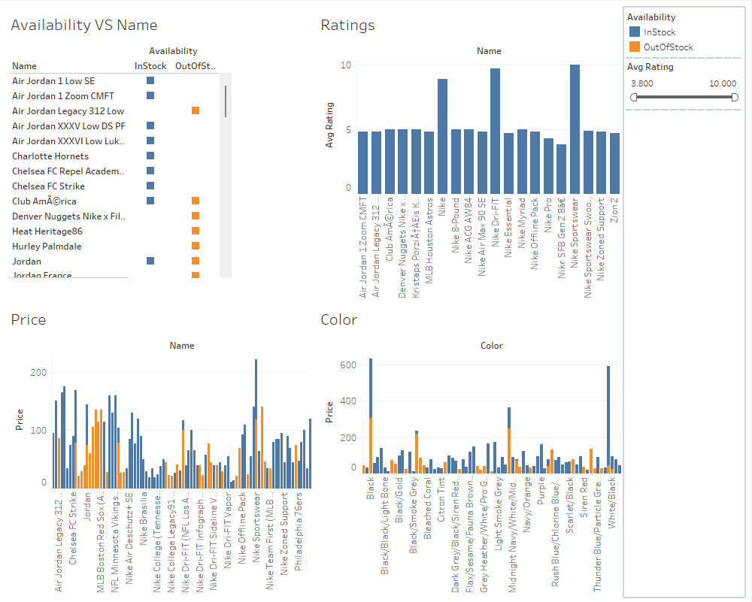
Dashboard

Slide 23
Conclusion
Inventory and Marketing Strategy Optimization provided actionable insights for inventory management and marketing strategy improvements.
The OLAP cube supports sophisticated analytical queries and dynamic report generation, enhancing Nike's ability to respond to market changes and consumer demands effectively.
With the help of dashboard, the maximum number of sales are Nike’s Jordans. Black is the popular color for Nike’s audience.
Nike sportswear has the highest price in Nike’s apparel section.

